Slide 1
Diffie-Hellman Key Exchange System
This lecture is mainly based on the power point slides by the textbook.
Notes:
Zili Shao

Slide 2
Diffie-Hellman Key Exchange
The first public-key type scheme proposed
by Diffie & Hellman in 1976 along with the exposition of public key concepts
Is practical for public exchange of a secret key
Is used in a number of commercial products
CEG 260, Meilin Liu
Notes:
Zili Shao
The idea of public key schemes, and the first practical scheme, which was for key distribution only, was published in 1977 by Diffie & Hellman. The concept had been previously described in a classified report in 1970 by James Ellis (UK CESG) - and subsequently declassified in 1987. See History of Non-secret Encryption (at CESG).

Slide 3
Diffie-Hellman Key Exchange
A public-key distribution scheme
  NOT used to exchange an arbitrary message
  BUT to establish a common key known only to the two participants
Value of key depends on the participants (and their private and public key information)
Based on exponentiation in a finite (Galois) field (modulo a prime or a polynomial) - easy
Security relies on the difficulty of computing discrete logarithms (similar to factoring) – hard
  Y =a^x (mod p)
  Given a, x, and p, it is easy to compute Y;
  but given y, a, p, it is very hard to get x.
CEG 260, Meilin Liu

Slide 4
Diffie-Hellman Setup
All users agree on global parameters:
  Large prime integer or polynomial p
  g: a primitive root (generator) of Zp*: a primitive root of a prime number p is a number g whose powers modulo p generate all the integers from 1 to p-1
Each user (eg. A) generates their key
  chooses a secret key (number): x < p
  compute their public key: Y = g^{x} mod p
Each user makes public that key Y
CEG 260, Meilin Liu
Notes:
Zili Shao
The prime q and primitive root α can be common to all using some instance of the D-H scheme. Note that the primitive root α is a number whose powers successively generate all the elements mod q. Alice and Bob choose random secrets x's, and then "protect" them using exponentiation to create the y's. For an attacker monitoring the exchange of the y's to recover either of the x's, they'd need to solve the discrete logarithm problem, which is hard.

Slide 5
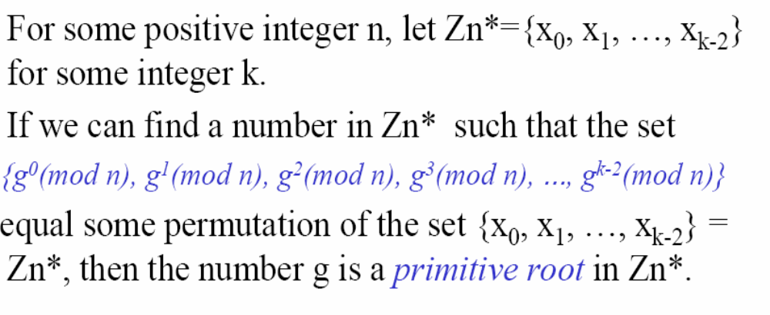
The Primitive Root (The Generator)
The number g is also called the generator of the group
{Zn*, x}.
CEG 260, Meilin Liu
Notes:
Zili Shao
All security policies and mechanisms rest on assumptions; we’ll examine some in later chapters, most notably Chapter 22, Malicious Logic. Here is a taste of the assumptions.
Policies: as these define security, they have to define security correctly for the particular site. For example, a web site has to be available, but if the security policy does not mention availability, the definition of security is inappropriate for the site. Also, a policy may not specify whether a particular state is “secure” or “non-secure.” This ambiguity causes problems.
Mechanisms: as these enforce policy, they must be appropriate. For example, cryptography does not assure availability, so using cryptography in the above situation won’t work. Further, security mechanisms rely on supporting infrastructure, such as compilers, libraries, the hardware, and networks to work correctly. Ken Thompson’s modified C preprocessor (see the example on p. 615) illustrates this point very well.

Slide 6
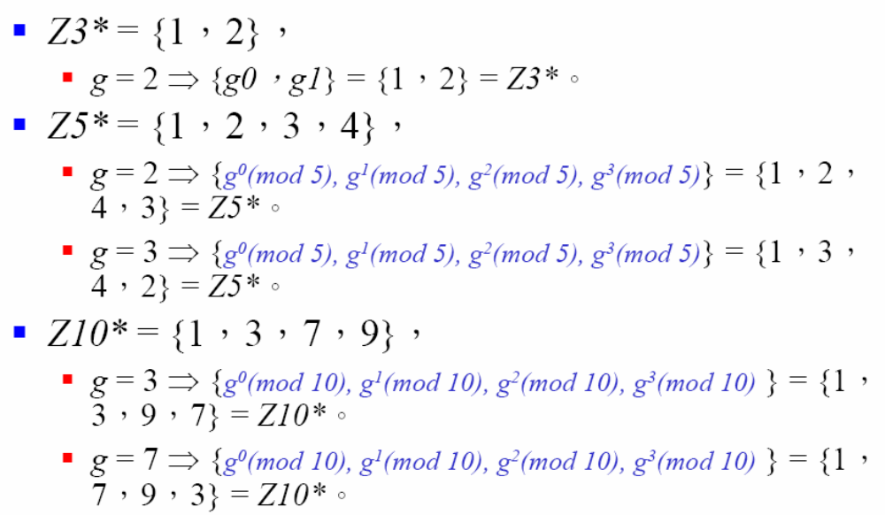
The Primitive Root (The generator)
CEG 260, Meilin Liu
Notes:
Zili Shao
All security policies and mechanisms rest on assumptions; we’ll examine some in later chapters, most notably Chapter 22, Malicious Logic. Here is a taste of the assumptions.
Policies: as these define security, they have to define security correctly for the particular site. For example, a web site has to be available, but if the security policy does not mention availability, the definition of security is inappropriate for the site. Also, a policy may not specify whether a particular state is “secure” or “non-secure.” This ambiguity causes problems.
Mechanisms: as these enforce policy, they must be appropriate. For example, cryptography does not assure availability, so using cryptography in the above situation won’t work. Further, security mechanisms rely on supporting infrastructure, such as compilers, libraries, the hardware, and networks to work correctly. Ken Thompson’s modified C preprocessor (see the example on p. 615) illustrates this point very well.

Slide 7
Diffie-Hellman Key Exchange System
1. Both Parties know the known value of a prime number p and its primitive root g
2. A randomly choose a large number x <p, and compute X =g^x (mod p)
3. A send the number X to B
4. B randomly choose a large number y < p, and compute Y =g^y (mod p)
5. B sends the number Y to A
6. A computes the private key Y^x = g^(x*y) (mod p)
7. B computes the private key X^y = g^(x*y) (mod p)
CEG 260, Meilin Liu
Notes:
Zili Shao
All security policies and mechanisms rest on assumptions; we’ll examine some in later chapters, most notably Chapter 22, Malicious Logic. Here is a taste of the assumptions.
Policies: as these define security, they have to define security correctly for the particular site. For example, a web site has to be available, but if the security policy does not mention availability, the definition of security is inappropriate for the site. Also, a policy may not specify whether a particular state is “secure” or “non-secure.” This ambiguity causes problems.
Mechanisms: as these enforce policy, they must be appropriate. For example, cryptography does not assure availability, so using cryptography in the above situation won’t work. Further, security mechanisms rely on supporting infrastructure, such as compilers, libraries, the hardware, and networks to work correctly. Ken Thompson’s modified C preprocessor (see the example on p. 615) illustrates this point very well.

Slide 8
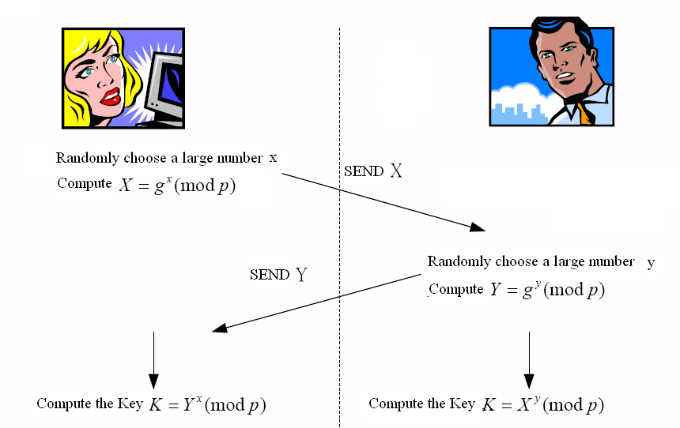
Diffie-Hellman Key Distribution System
CEG 260, Meilin Liu
Notes:
Zili Shao
All security policies and mechanisms rest on assumptions; we’ll examine some in later chapters, most notably Chapter 22, Malicious Logic. Here is a taste of the assumptions.
Policies: as these define security, they have to define security correctly for the particular site. For example, a web site has to be available, but if the security policy does not mention availability, the definition of security is inappropriate for the site. Also, a policy may not specify whether a particular state is “secure” or “non-secure.” This ambiguity causes problems.
Mechanisms: as these enforce policy, they must be appropriate. For example, cryptography does not assure availability, so using cryptography in the above situation won’t work. Further, security mechanisms rely on supporting infrastructure, such as compilers, libraries, the hardware, and networks to work correctly. Ken Thompson’s modified C preprocessor (see the example on p. 615) illustrates this point very well.

Slide 9
Diffie-Hellman Key Exchange
shared session key for users A & B is K_{AB}:
  K_{AB} = g^xy mod p
  = X^y mod p (which B can compute)
  = Y^x mod p (which A can compute)
K_{AB} is used as session key in private-key encryption scheme between Alice and Bob
if Alice and Bob subsequently communicate, they will have the same key as before, unless they choose new public-keys
attacker needs an x, must solve discrete log
Attacker sees g^x, g^y, and supposedly can’t compute g^xy.
CEG 260, Meilin Liu
Notes:
Zili Shao
The actual key exchange for either party consists of raising the others "public key' to power of their private key. The resulting number (or as much of as is necessary) is used as the key for a block cipher or other private key scheme. For an attacker to obtain the same value they need at least one of the secret numbers, which means solving a discrete log, which is computationally infeasible given large enough numbers

Slide 10
Diffie-Hellman Example
users Alice & Bob who wish to swap keys:
agree on prime p=353 and g=3
select random secret keys:
  A chooses x =97, B chooses y =233
compute public keys:
  X =3⁹⁷ mod 353 = 40 (Alice)
  Y =3²³³ mod 353 = 248 (Bob)
compute shared session key as:
  K_{AB}= Y^x mod 353 = 248⁹⁷ = 160 (Alice)
  K_{AB}= X^y mod 353 = 40²³³ = 160 (Bob)
CEG 260, Meilin Liu
Notes:
Zili Shao

Slide 11
Man-in-the-Middle Attack
The man-in-the-middle attack (often abbreviated MITM, MitM, MIM, MiM) in cryptography and computer security is a form of active eavesdropping in which the attacker makes independent connections with the victims and relays messages between them, making them believe that they are talking directly to each other over a private connection, when in fact the entire conversation is controlled by the attacker. The attacker must be able to intercept all messages going between the two victims and inject new messages, which is straightforward in many circumstances.
For example, an attacker within reception range of an unencrypted Wi-Fi wireless access point, can insert himself as a man-in-the-middle.
Notes:
The protocol described on the previous slide is insecure against a man-in-the-middle attack. Suppose Alice and Bob wish to exchange keys, and Darth is the adversary. The attack proceeds as follows:
Darth prepares for the attack by generating two random private keys X_{D1} and X_{D2} and then computing the corresponding public keys Y_{D1} and Y_{D2}
Alice transmits Y_{A} to Bob.
Darth intercepts Y_{A} and transmits Y_{D1} to Bob. Darth also calculates K2 = (Y_{A} )^ X_{D2} mod q
Bob receives Y_{D1} and calculates K1=(Y_{D1} )^ X_{B} mod q
Bob transmits Y_{B} to Alice.
Darth intercepts Y_{B} and transmits Y_{D2} to Alice. Darth calculates K1=(Y_{B} )^ X_{D1} mod q
Alice receives Y_{D2} and calculates K2=(Y_{D2} )^ X_{A} mod q .
At this point, Bob and Alice think that they share a secret key, but instead Bob and Darth share secret key K1 and Alice and Darth share secret key K2. All future communication between Bob and Alice is compromised in the following way:
Alice sends an encrypted message M: E(K2, M).
Darth intercepts the encrypted message and decrypts it, to recover M.
Darth sends Bob E(K1, M) or E(K1, M'), where M' is any message. In the first case, Darth simply wants to eavesdrop on the communication without altering it. In the second case, Darth wants to modify the message going to Bob. The key exchange protocol is vulnerable to such an attack because it does not authenticate the participants. This vulnerability can be overcome with the use of digital signatures and public- key certificates.

Slide 12
Man-in-the-Middle Attack
Darth prepares by creating a pair of private / public keys
Alice transmits her public key to Bob
Darth intercepts this and transmits his public key Z to Bob. Darth also calculates a shared key with Alice
Bob receives the public key and calculates the shared key (with Darth instead of Alice)
Bob transmits his public key , Z, to Alice
Darth intercepts this and transmits his public key to Alice. Darth calculates a shared key with Bob
Alice receives the key and calculates the shared key (with Darth instead of Bob)
Darth can then intercept, decrypt, re-encrypt, forward all messages between Alice & Bob
Notes:
The protocol described on the previous slide is insecure against a man-in-the-middle attack. Suppose Alice and Bob wish to exchange keys, and Darth is the adversary. The attack proceeds as follows:
Darth prepares for the attack by generating two random private keys X_{D1} and X_{D2} and then computing the corresponding public keys Y_{D1} and Y_{D2}
Alice transmits Y_{A} to Bob.
Darth intercepts Y_{A} and transmits Y_{D1} to Bob. Darth also calculates K2 = (Y_{A} )^ X_{D2} mod q
Bob receives Y_{D1} and calculates K1=(Y_{D1} )^ X_{B} mod q
Bob transmits Y_{B} to Alice.
Darth intercepts Y_{B} and transmits Y_{D2} to Alice. Darth calculates K1=(Y_{B} )^ X_{D1} mod q
Alice receives Y_{D2} and calculates K2=(Y_{D2} )^ X_{A} mod q .
At this point, Bob and Alice think that they share a secret key, but instead Bob and Darth share secret key K1 and Alice and Darth share secret key K2. All future communication between Bob and Alice is compromised in the following way:
Alice sends an encrypted message M: E(K2, M).
Darth intercepts the encrypted message and decrypts it, to recover M.
Darth sends Bob E(K1, M) or E(K1, M'), where M' is any message. In the first case, Darth simply wants to eavesdrop on the communication without altering it. In the second case, Darth wants to modify the message going to Bob. The key exchange protocol is vulnerable to such an attack because it does not authenticate the participants. This vulnerability can be overcome with the use of digital signatures and public- key certificates.

Slide 13



Man-in-the-Middle Attack
Most serious weakness in Diffie-Hellman
Assumes Darth has ability to:
  Intercept messages between Alice and Bob
  Masquerade as Alice or Bob to send messages to the other
“I am Bob”
“I am Alice”

Slide 14
Man-in-the-Middle Attack
Darth generates own random value z
Computes own Z = g^{z} mod p from public values of p, g
Goal:
Trick Alice and Bob into using keys he has created from z

Slide 15
Man-in-the-Middle Attack
Darth intercepts X sent by Alice
and Y sent by Bob
Computes k_{Alice} = X ^{z} mod p
Computes k_{Bob} =Y^{z} mod p
X
Y
z Z
k_{Alice} k_{Bob}
x
y

Slide 16
Man-in-the-Middle Attack
Darth sends Z to Alice posing as Bob
Darth sends Z to Bob posing as Alice
Alice computes k_{Alice} = Z ^{x} mod p
Bob computes k_{Bob} = Z ^{y} mod p
Z
Z
k_{Alice}
k_{Alice} k_{Bob}
k_{Bob}

Slide 17
Man-in-the-Middle Attack
Darth can read messages sent by Alice and Bob!
Example: Message sent from Alice to Bob
  Alice encrypts with k_{Alice} believing it is secure
  Darth intercepts and decrypts with k_{Alice}
  Re-encrypts with k_{Bob} and sends to Bob (posing as Alice
C = E(P, k_{Alice})
C = E(P, k_{Bob})
P = D(C, k_{Alice})

Slide 18
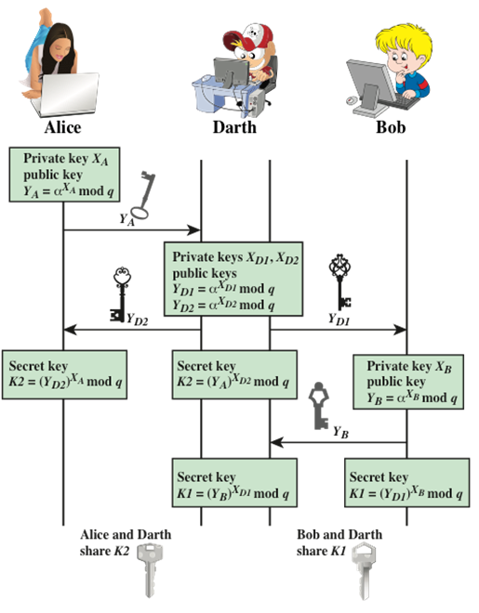
Man-in-the-Middle Attack

Slide 19
Station-to-Station Key Agreement
Participants in Diffie-Hellman must authenticate their identities
  Only solution to Man-in-the-Middle attack
Authentication usually based on certificates
  Signed by trusted authorities
  Contain public keys for participants
  Information signed with private key
  Information verified with corresponding public key contained in certificate

Slide 20
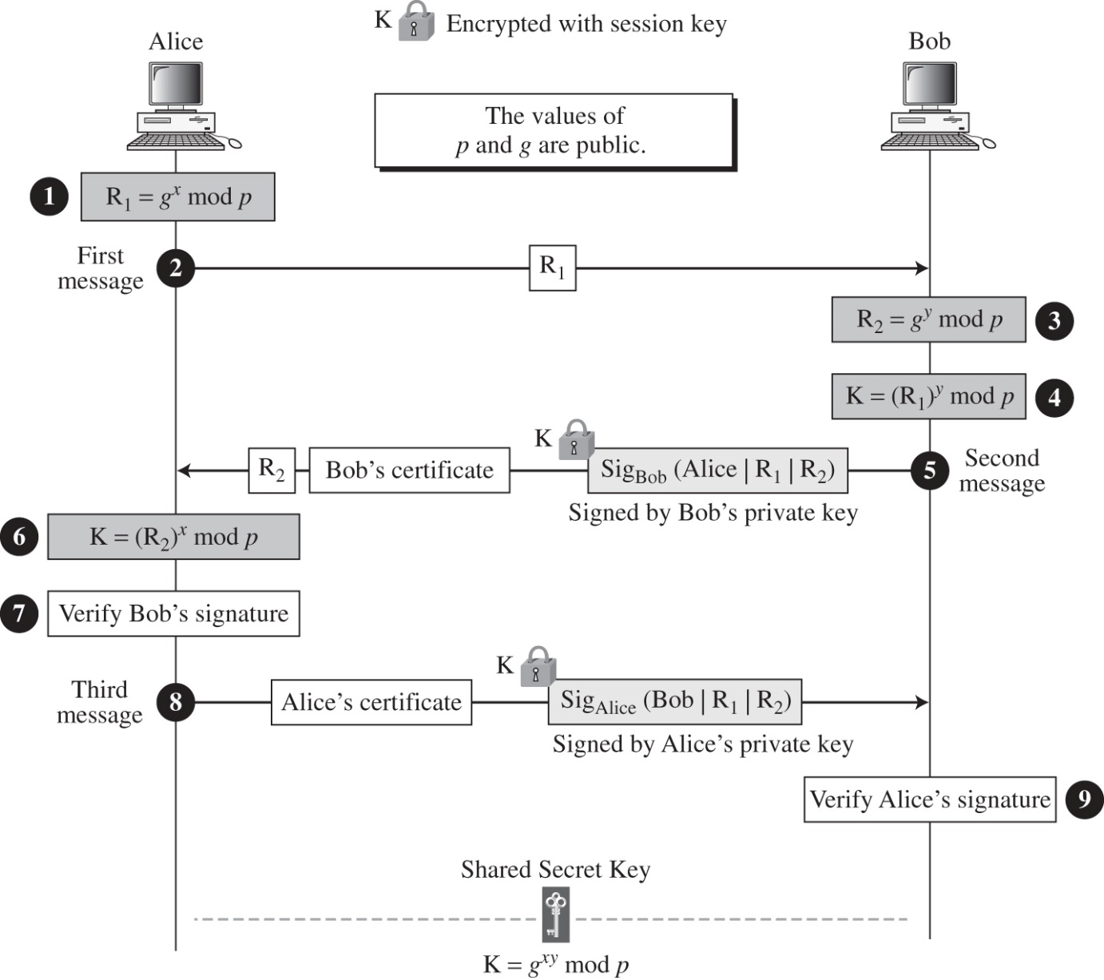
Station-to-Station Key Agreement

Slide 21
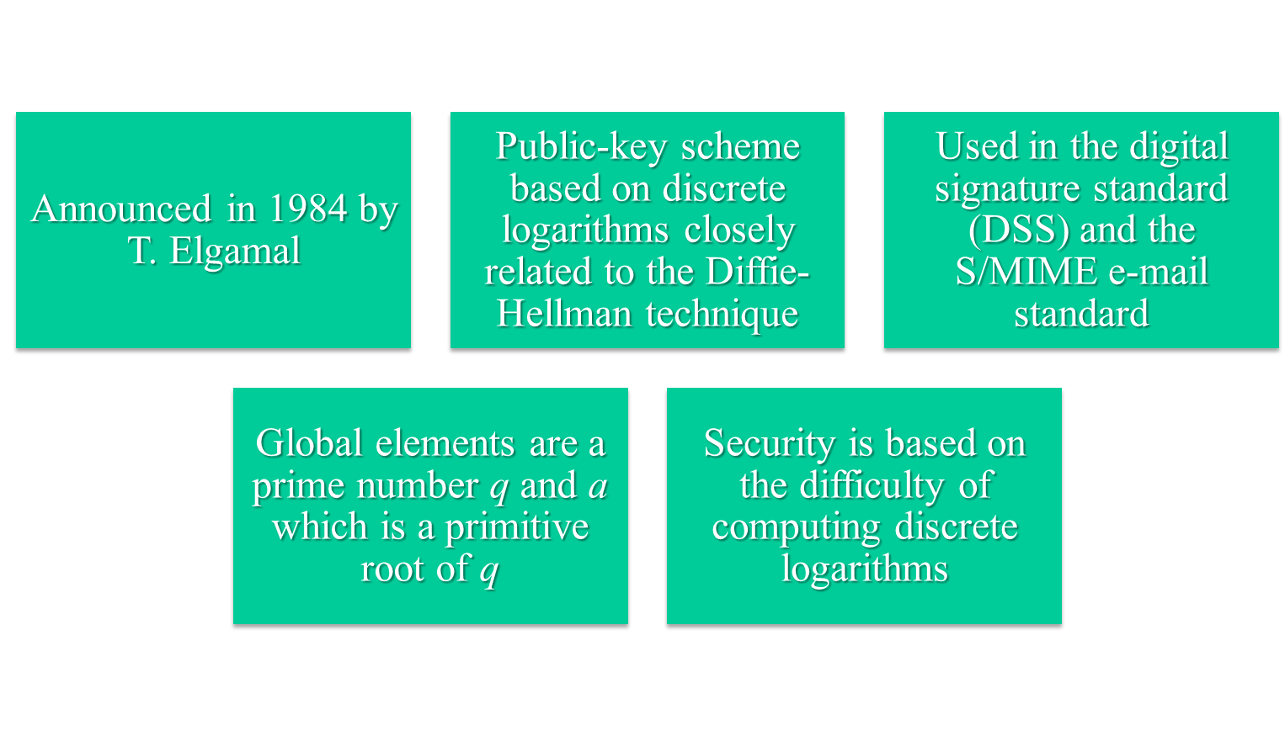
ElGamal Cryptography
© 2017 Pearson Education, Inc., Hoboken, NJ. All rights reserved.
Notes:
In 1984, T. Elgamal announced a public-key scheme based on discrete logarithms, closely related to the Diffie-Hellman technique [ELGA84, ELGA85]. The ElGamal cryptosystem is used in some form in a number of standards including the digital signature standard (DSS) and the S/MIME email standard.
As with Diffie-Hellman, the global elements of ElGamal are a prime number q and a, which is a primitive root of q. User A generates a private/public key pair. The security of ElGamal is based on the difficulty of computing discrete logarithms, to recover either x given y, or k given K .
The security of Elgamal is based on the difficulty of computing discrete
logarithms.

Slide 22
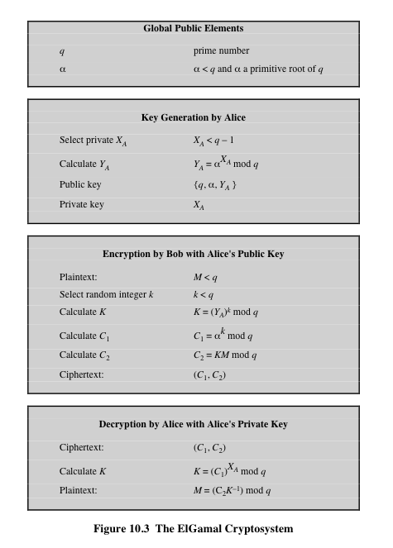
© 2017 Pearson Education, Inc., Hoboken, NJ. All rights reserved.
Notes:
Figure 10.3 summarizes the ElGamal Cryptosystem. It corresponds to Figure 9.1a.
Alice generates a public/private key pair; Bob encrypts using Alice’s public key; and
Alice decrypts using her private key.

Slide 23
Setting up ElGamal: example
Step 1: Let p = 23
Step 2: Select a primitive element g = 11
Step 3: Choose a private key x = 6
Step 4: Compute y = 11⁶ (mod 23)
= 9
Public key is 9
Private key is 6
Introduction to Cryptography and Security Mechanisms 2005

Slide 24
ElGamal encryption
The first job is to represent the plaintext as a series of numbers modulo p. Then:
Generate a random number k
Compute K = y^{k} mod p
Compute two values C₁ and C₂, where
C₁ = g^{k} mod p and C₂ = MK mod p
Send the ciphertext C, which consists of the two separate values C₁ and C₂.
Introduction to Cryptography and Security Mechanisms 2005

Slide 25
ElGamal encryption: example
To encrypt M = 10 using Public key 9
1 - Generate a random number k = 3
2- Calculate K= 9³ mod 23 = 16
3 - Compute C₁= 11³ mod 23 = 20
C₂= 10 x 9³ mod 23
= 10 x 16 = 160 mod 23 = 22
4 - Ciphertext C = (20 , 22 )
Introduction to Cryptography and Security Mechanisms 2005

Slide 26
ElGamal decryption
C₁ = g^{k} mod p C₂ = MK mod p
1 - The receiver begins by using their private key x to transform C₁ into something more useful:
C₁^{x} = (g^{k})^{x} mod p
NOTE: C₁^{x} = (g^{k})^{x} = (g^{x})^{k} = (y)^{k} = y^{k} mod p =K
2 - This is a very useful quantity because if you divide C₂ by it you get M. In other words:
C₂ / K= (MK) / K = M mod p
Introduction to Cryptography and Security Mechanisms 2005

Slide 27
ElGamal decryption: example
To decrypt C = (20 , 22 )
1 - Compute 20⁶ = 16 mod 23
2 - Compute 22 / 16 = 10 mod 23
3 - Plaintext = 10
Introduction to Cryptography and Security Mechanisms 2005

Slide 28
ElGamal: converting Diffie-Hellman to pub-key enc. (1984)
Fix a finite cyclic group G (e.g G = Zp* )
Fix a generator g in G (i.e. G = {1, g, g², g³, … , g^{p-2}} )
Treat as a public key
Alice
Bob
choose random a in {1,…,p-1}
choose random b in {1,…,p-1}
A = g^a mod p
compute g^{ab} = A^b mod p,
derive symmetric key k ,
encrypt message m with k
ct = [ , ]
B = g^b mod p
Notes:
ElGamal: Hellman student.
First flow happens at one point. Second flow may happen much later.
Secret key = a

Slide 29
ElGamal: converting to pub-key enc. (1984)
Fix a finite cyclic group G (e.g G = Zp* )
Fix a generator g in G (i.e. G = {1, g, g², g³, … , g^{p-2}} )
Treat as a public key
Alice
Bob
choose random a in {1,…,p-1}
choose random b in {1,…,p-1}
A = g^a mod p
compute g^{ab} = A^{b} mod p,
derive symmetric key k ,
encrypt message m with k
ct = [ , ]
B = g^b mod p
To decrypt:
compute g^{ab} = Bª mod p,
derive k, and decrypt
Notes:
ElGamal: Hellman student.
First flow happens at one point. Second flow may happen much later.

Slide 30
The ElGamal system (a modern view)
Fix a finite cyclic group G (e.g G = Zp* )
Fix a generator g in G (i.e. G = {1, g, g², g³, … , g^{p-2}} )
(E_{s}, D_{s}) : symmetric auth. encryption defined over (K,M,C)
H: G² ⟶ K: a hash function
We construct a pub-key enc. system (Gen, E, D):
Key generation Gen: (pk, sk)
  choose random generator g in Zp* and random a in Zp*
  output sk = a, pk = (g, h= g^a mod p)
Notes:
Call pub-key “h” instead of “A”

Slide 31
The ElGamal system (a modern view)
Fix a finite cyclic group G (e.g G = Zp* )
Fix a generator g in G (i.e. G = {1, g, g², g³, … , g^{p-2}} )
(E_{s}, D_{s}) : symmetric auth. encryption defined over (K,M,C)
H: G² ⟶ K a hash function
Bob:
E( pk=(g, h), m) :
b ⟵ Zp* , u ⟵ g^b mod p, v ⟵ h^b mod p
k ⟵ H(u,v) , c ⟵ E_{s}(k, m)
output (u, c)
R
Alice:
D( sk=a, (u,c) ) :
v ⟵ uª
k ⟵ H(u,v) , m ⟵ D_{s}(k, c)
output m

Slide 32
Recap: public key encryption: (Gen, E, D)
Gen
pk
sk
m
E
c
c
D
m
Notes:
Note: asymmetric keys

Slide 33


Recap: public-key encryption applications
Key exchange (e.g. in HTTPS)
Encryption in non-interactive settings:
Secure Email: Bob has Alice’s pub-key and sends her an email
Encrypted File Systems
sk_{A}
write
read
Alice
E(pk_{A}, K_{F})
Bob
File
E(k_{F}, File)
E(pk_{B}, K_{F})

Slide 34
Recap: public-key encryption applications
Key exchange (e.g. in HTTPS)
Encryption in non-interactive settings:
Secure Email: Bob has Alice’s pub-key and sends her an email
Encrypted File Systems
Key escrow: data recovery without Bob’s key
Escrow
Service
write
sk_{escrow}
E(pk_{escrow}, K_{F})
Bob
E(k_{F}, File)
E(pk_{B}, K_{F})
Notes:
Describe this in corporate settings. Bob’s key is no longer available, but need access to his files.
Escrow service is offline until needed.

Slide 35
Public Key Cryptography Recap
Two families of public-key encryption schemes
RSA: based on trapdoor functions
  Schemes: ISO standard, OAEP+, …
ElGamal encryption: based on the Diffie-Hellman protocol
  Schemes: ElGamal encryption and variants (e.g. used in GPG (GNU privacy guard)
Security goals: chosen ciphertext security
Notes:
GPG = Gnu Privacy Guard

